Slide 1
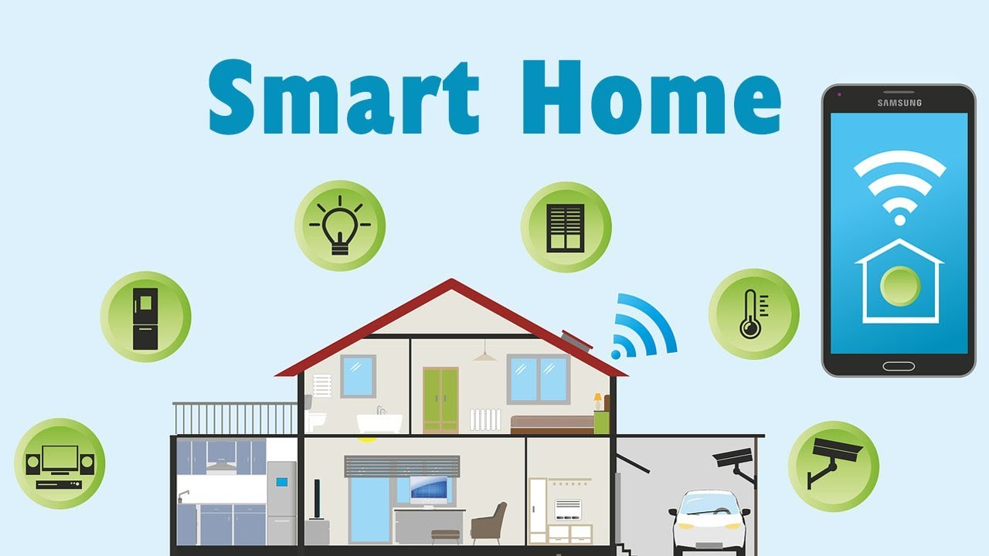

Unit –5
IoT Physical Devices and End Point

Slide 2
Arduino:
Arduino is an open-source electronics platform based on easy- to-use hardware and software.
Arduino boards are able to read inputs - light on a sensor, a finger on a button, or a Twitter message - and turn it into an output - activating a motor, turning on an LED, publishing something online.

Slide 3
Arduino UNO:
Arduino Uno is a microcontroller board based on the ATmega328P.
It has 14 digital input/output pins (of which 6 can be used as PWM outputs), 6 analog inputs, a 16 MHz quartz crystal, a USB connection, a power jack, an ICSP header and a reset button.
"Uno" means one in Italian and was chosen to mark the release of Arduino Software (IDE) 1.0. The Uno board and version 1.0 of Arduino Software (IDE) were the reference versions of Arduino, now evolved to newer releases.

Slide 4
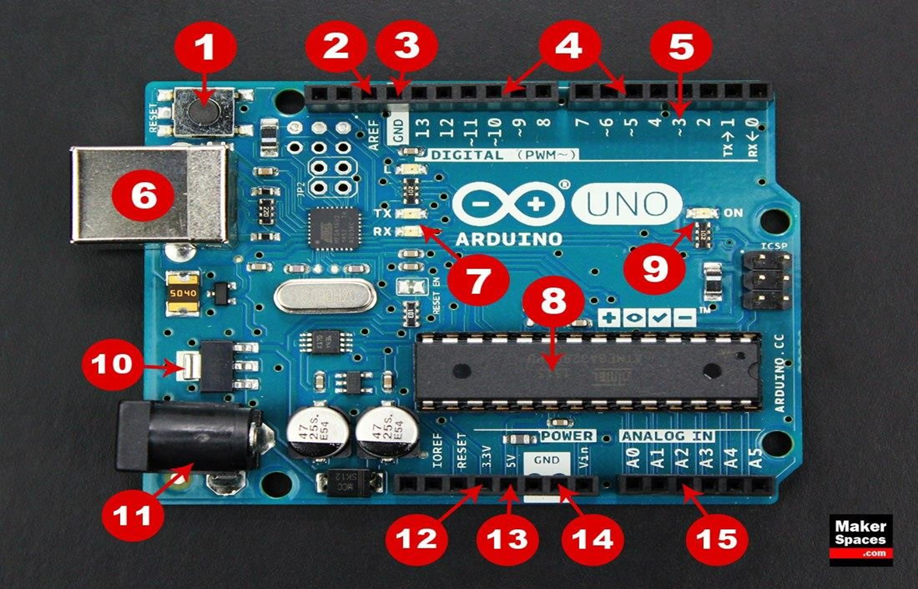

Slide 5
1. Reset Button – This will restart any code that is loaded to the Arduino board
2. AREF – Stands for “Analog Reference” and is used to set an external reference voltage
3. Ground Pin – There are a few ground pins on the Arduino and they all work the same
4. Digital Input/Output – Pins 0-13 can be used for digital input or output
5. PWM – The pins marked with the (~) symbol can simulate analog output
6. USB Connection – Used for powering up your Arduino and uploading sketches
7. TX/RX – Transmit and receive data indication LEDs

Slide 6
8. ATmega Microcontroller – This is the brains and is where the programs are stored
9. Power LED Indicator – This LED lights up anytime the board is plugged in a power source
10. Voltage Regulator – This controls the amount of voltage going into the Arduino board
11. DC Power Barrel Jack – This is used for powering your Arduino with a power supply
12. 3.3V Pin – This pin supplies 3.3 volts of power to your projects
13. 5V Pin – This pin supplies 5 volts of power to your projects
14. Ground Pins – There are a few ground pins on the Arduino and they all work the same
15. Analog Pins – These pins can read the signal from an analog sensor and convert it to digital

Slide 7
Fundamentals of Arduino Programming:
Two required functions / methods / routines:
void setup()
{
// runs once
}
void loop()
{
// repeats
}

Slide 9
Comments
// this is for single line comments
// it’s good to put at the top and before anything ‘tricky’
/* this is for multi-line comments
Like this…
And this….
*/

Slide 11
pinMode(pin, INPUT/OUTPUT);
ex: pinMode(13, OUTPUT);
digitalWrite(pin, HIGH/LOW);
ex: digitalWrite(13, HIGH);
delay(time_ms);
ex: delay(2500); // delay of 2.5 sec.
// NOTE: -> commands are CASE-sensitive

Slide 12
Arduino programs run on two basic sections:
void setup() {
//setup motors, sensors etc
}
void loop() {
// get information from sensors
// send commands to motors
}

Slide 13
setup():
The setup section is used for assigning input and outputs (Examples: motors, LED’s, sensors etc) to ports on the Arduino
It also specifies whether the device is OUTPUT or INPUT To do this we use the command “pinMode”

Slide 14
loop()

Slide 15
DECLARING A VARIABLE

Slide 16
USING VARIABLES

Slide 17
USING VARIABLES

Slide 18
Conditions
To make decisions in Arduino code we use an ‘if’ statement
‘If’ statements are based on a TRUE or FALSE question
VALUE COMPARISONS

Slide 19
IF Condition

Slide 20

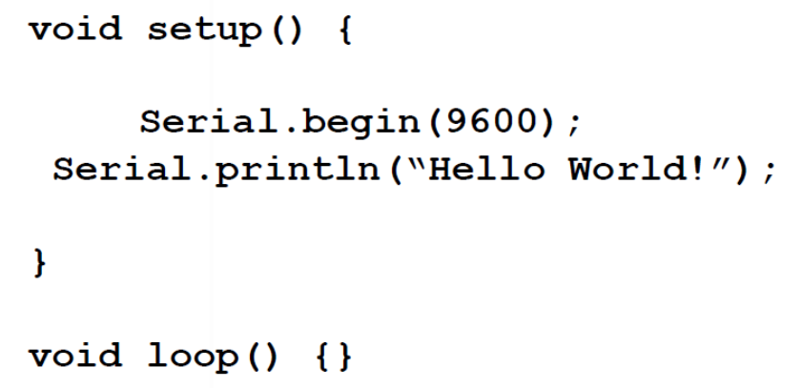
Serial Monitor
It is part of the Arduino IDE software.
It allow to send messages from computer to an Arduino board (over USB) and also to receive messages from the Arduino.
The Serial Monitor is an essential tool when creating projects with Arduino. It can be used as a debugging tool, testing out concepts or to communicate directly with the Arduino board.

Slide 21
Program 1: To illustrate the use of serial monitor.
Program 2: To control a DC Motor using ultrasonic distance sensor.

Slide 23
IF - ELSE Condition

Slide 24
IF - ELSE Condition

Slide 25
IF - ELSE Example

Slide 26
IF - ELSE IF Condition

Slide 27
IF - ELSE IF Example

Slide 28
BOOLEAN OPERATORS
If we want all of the conditions to be true we need to use ‘AND’ logic (AND gate)
We use the symbols &&
If we want either of the conditions to be true we need to use ‘OR’ logic (OR gate) We use the symbols II

Slide 29
BOOLEAN VARIABLES

Slide 30
Important functions
• Serial.println(value);
Prints the value to the Serial Monitor on your computer
• pinMode(pin, mode);
Configures a digital pin to read (input) or write (output) a digital value
• digitalRead(pin);
Reads a digital value (HIGH or LOW) on a pin set for input
• digitalWrite(pin, value);
Writes the digital value (HIGH or LOW) to a pin set for output

Slide 31
Raspberry Pi

Slide 32
Introduction to Raspberry Pi
Raspberry Pi is a low-cost mini-computer with the physical size of a credit card.
Raspberry Pi runs various ﬂavors of Linux and can perform almost all tasks that a normal desktop computer can do.
Raspberry Pi also allows interfacing sensors and actuators through the general purpose I/O pins.

Slide 33
Generations of Raspberry Pi
The first generation (RaspberryPi I Model B) was released in February 2012, followed by a simpler and inexpensive model A.
In 2014, the foundation released a board with an improved design in Raspberry I Model B+. The model laid the current "mainline" form factor. Improved A+ and B+ models were released a year later.
A cut down "compute module" was released in April 2014, and a RaspberryPi Zero with smaller size and limited input/output (1/0) and general purpose input/output (GPIO) abilities was released in November 2015.
The RaspberryPi 2 which added more RAM was released in February 2015.

Slide 34
RaspberryPi 3 model B released in February 2016 is bundled with on-board Wi-Fi and Bluetooth.
The latest addition to the family is the Raspberry Pi 4 Model B that now features a quad-core 1.5Ghz processor with 2GB, 4GB and 8GB RAM.
All models feature a Broadcom system on a chip(SoC), which includes an ARM compatible central processing unit (CPU) and an on chip graphics processing unit (GPU, a Video Core IV).
CPU speed ranges from 700 MHz to 1.2GHz for the Pi 3 and on board memory range from 256MB to 1GB RAM.
Secure Digital (SD) cards are used to store the operating system and program memory in either the SDHC or Micro SDHC sizes.

Slide 35
Most boards have between one and four USB slots, HDMI and composite video output, and a 3.5 mm phone jack for audio.
Lower-level output is provided by a number of GPIO pins which support common protocols like l2C.
The B-models have an SP*C Ethernet port and the Pi 3 has on board Wi-Fi 802.11n and Bluetooth.
The Foundation provides Raspbian, a Debian-based Linux distribution for download, as well as third party ubuntu, windows 10 loT core, RISC OS, and specialized media center distributions.

Slide 36
Foundation also provides Python and Scratch as the main programming language, with support for many other languages.
The default firmware is closed source, while an unofficial open source is available.
"Why RaspberryPi?" –
Inexpensive, Cross-platform , Simple, clear programming environment, Open source and extensible software and Open source and extensible hardware.

Slide 37
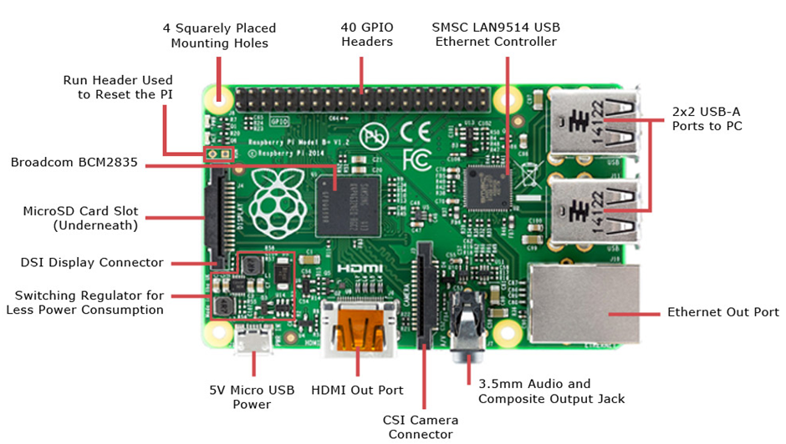
About the RaspberryPi Board: Hardware Layout

Slide 38
Raspberry Pi GPIO

Slide 39
Raspberry Pi Interfaces
Serial
The serial interface on Raspberry Pi has receive (Rx) and transmit (Tx) pins for communication with serial peripherals.
SPI
Serial Peripheral Interface (SPI) is a synchronous serial data protocol used for communicating with one or more peripheral devices.
I2C
The I2C interface pins on Raspberry Pi allow you to connect hardware modules. I2C interface allows synchronous data transfer with just two pins – SDA (data line) and SCL (clock line).

Slide 40
Raspberry Pi Operating systems
Various operating systems can be installed on Raspberry pi through SD cards.
Most use a MicroSD slot located on the bottom of the board. The Raspberrypi primarily uses Raspbian, a Debian-based Linux operating system.
Other third party operating systems available via the official website include Ubuntu MATE, Snappy Ubuntu Core, Windows 10 IoT Core, RISC OS and specialized distributions for the Kodi media center and classroom management.
Many other operating systems can also run on the Raspberry pi.

Slide 41
Raspberry Pi Operating systems
Operating Systems (not Linux based): RISC OS Pi, Windows 10 IOT-core
Operating Systems (Linux based): Pidora, Diet Pi
Media center operating systems: OSMC, OpenELEC
Audio operating systems: Volumio, Pimusicbox
RealBox: Happi Game Center, Piplay

Slide 42
Raspberry Pi Operating systems Installation(Manual)
Formatting SD card:
Format the SD card before copying NOOBS onto it. To do this
I. Download SD fomater 4.0 from SD Association website for either Windows or Mac.
2. Follow the instructions to install the software.
3. Insert the SD card into the computer or laptops SD card reader and make a note of the drive letter allocated to it
4. In SD formatter, select the drive letter the SD card is and format it.

Slide 43
OS installation:
1. Go to raspberry pi foundation website and click on DOWNLOAD section.
2. Click on NOOBS, then click on the "Download ZIP" button under NOOBS and select a folder to save this ZIP file.
3. Extract all the files from ZIP.
4. Once SD card has been formatted, drag all the files in the extracted NOOBS folder and drop them onto the SD card drive.
5. The necessary files will then be transferred to the SD card.
6. When this process has finished, safely remove the SD card and insert it into the Raspberry Pi.

Slide 44
First Boot:
I. Plug in the keyboard, mouse, and monitor cables.
2. Now plug the USB cable into the Raspberry pi.
3. Now Raspberry Pi will boot, and a window will appear with a list of different operating systems that we can install. We recommend using Raspbian- tick the box next to Raspbian and clicking on install.
4. Raspbian will then run through its installation process. Note that this can take a while.
5. When the install process has completed, the Raspberry pi configuration menu (raspi-config) will load. Here we should set the time and date for our region, enable a Raspberry pi camera board, or even create users.

Slide 45
LOGIN Information:
The default login for Raspbian is username "pi" with the password "raspberry". To load the graphical user interface, type "startx" and press "Enter".

Slide 46
Raspberry Pi Operating systems Installation using Raspberry Pi Imager
Raspberry Pi Imager is the quick and easy way to install Raspberry Pi OS and other operating systems to a microSD card, ready to use with y Raspberry Pi.
Download and install Raspberry Pi Imager to a computer with an SD card reader.
Put the SD card that will be used with Raspberry Pi into the reader and run Raspberry Pi Imager.
First format the SD card with Erase option.
Choose the Operating system to be installed and choose the storage location and Click on Write.

Slide 49
Programming Raspberry Pi with Python
Program 1: Blinking an LED

Slide 54
Program 2: Interacting with the user

Slide 58
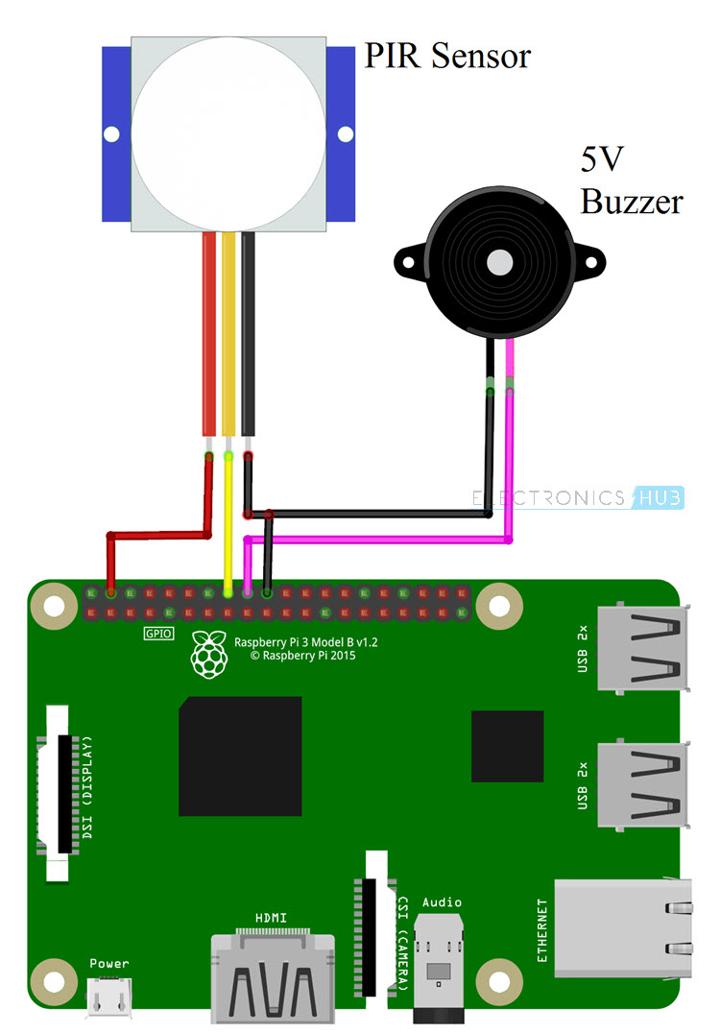
Program 3: Passive Infrared Sensor
Connect the VCC and GND pins of the PIR Motion Sensor to +5V and GND pins of the Raspberry Pi. Connect the DATA Pin of the PIR Sensor to GPIO23 i.e. Physical Pin 7 of the Raspberry Pi.
A 5V Buzzer is connected to GPIO27 i.e. Physical Pin 18 of the Raspberry Pi. The other pin of the buzzer is connected to GND.

Slide 63
Wireless Temperature Monitoring System Using Pi:
Raspberry Pi which having inbuilt wi-fi, which makes Raspberry Pi to suitable for IoT applications, so that by using IoT technology
This monitoring system works by uploading the temperature value to the Thingspeak cloud.
In this monitoring system, Thingspeak cloud is used, the cloud which is suitable to view the sensor logs in the form of graph plots.
ThingSpeak is an IoT analytics platform service that allows you to aggregate, visualize, and analyze live data streams in the cloud.
we can send data to ThingSpeak from our devices, create instant visualization of live data, and send alerts.

Slide 64
Steps for building Raspberry Pi Data Logger on Cloud
Step 1: Signup for ThingSpeak. ...
Step 2: Create a Channel for Your Data. ...
Step 3: Getting API Key in ThingSpeak. ...
Step 4: Python Code for Raspberry Pi Temperature Monitoring. ...
Step 6: Check ThingSpeak site for Temperature Logging.

Slide 65
DS18B20 Temperature Sensor
The DS18B20 is a 1-wire programmable Temperature sensor from maxim integrated.
It is widely used to measure temperature in hard environments like in chemical solutions, mines or soil etc.
The construction of the sensor is rugged and also can be purchased with a waterproof option making the mounting process easy.
It can measure a wide range of temperature from -55°C to +125° with a decent accuracy of ±5°C.
Each sensor has a unique address and requires only one pin of the MCU to transfer data so it a very good choice for measuring temperature at multiple points without compromising much of the digital pins on the microcontroller.

Slide 66
Applications:
Measuring temperature at hard environments
Liquid temperature measurement
Applications where temperature has to be measured at multiple points
Pin Configuration:
No Pin Name Description
1 Ground Connect to the ground of the circuit
2 Vcc Powers the Sensor, can be 3.3V or 5V
3 Data This pin gives output the temperature value which can be read using 1-wire method

Slide 67
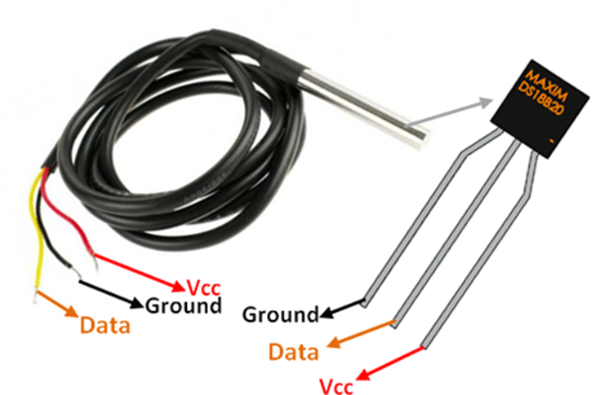

Slide 68
Accessing Temperature from DS18B20 sensors:
The DS18B20 is a digital thermometer that allows to get 9-bit to 12-bit Celsius temperature measurements (programmable resolution).
The temperature conversion time depends on the resolution used.
For a 9-bit resolution it takes at most 93.75 ms and for a 12-bit resolution it takes at most 750 ms.
The device is able to measure temperatures from -55°C to +125°C and has a ±0.5°C accuracy in the range from -10°C to +85°C.

Slide 69
Accessing Temperature from DS18B20 sensors:
Additionally, it has an alarm functionality with programmable upper and lower temperature trigger points.
These thresholds are stored internally in non-volatile memory, which means they are kept even if the device is powered off .
The sensor communicates using the One Wire protocol, which means it only requires a pin from a microcontroller to be connected to it.
Furthermore, each sensor has a unique 64-bit serial code, allowing multiple DS18B20 devices to function on the same One Wire bus.
In terms of power supply, the device can operate with a voltage between 3.0 V and 5.5 V,

Slide 70
Connecting Raspberry Pi via SSH:
The command line of a Raspberry Pi can be accessed remotely from another computer or device on the same network using SSH. The Raspberry Pi will act as a remote device: We can connect to it using a client on another machine.
1. Set up your local network and wireless connectivity
2. Enable SSH
3. Enable SSH on a headless Raspberry Pi (add file to SD card on another machine)
Set up
https://www.raspberrypi.org/documentation/remote-access/ssh/ your client

Slide 71
Remote access to RaspberryPi:
Remote Log Into Your Raspberry Pi’s Full Operating System Using VNC Connect:
VNC has long been the best way to access any computer remotely on the same network. Recently, VNC Connect came out to make it easy to access your Raspberry Pi from anywhere using a cloud connection.
Once it’s set up, you can access your Raspberry Pi’s graphic interface from any other computer or smartphone using the VNC Viewer app.

